Slide 1
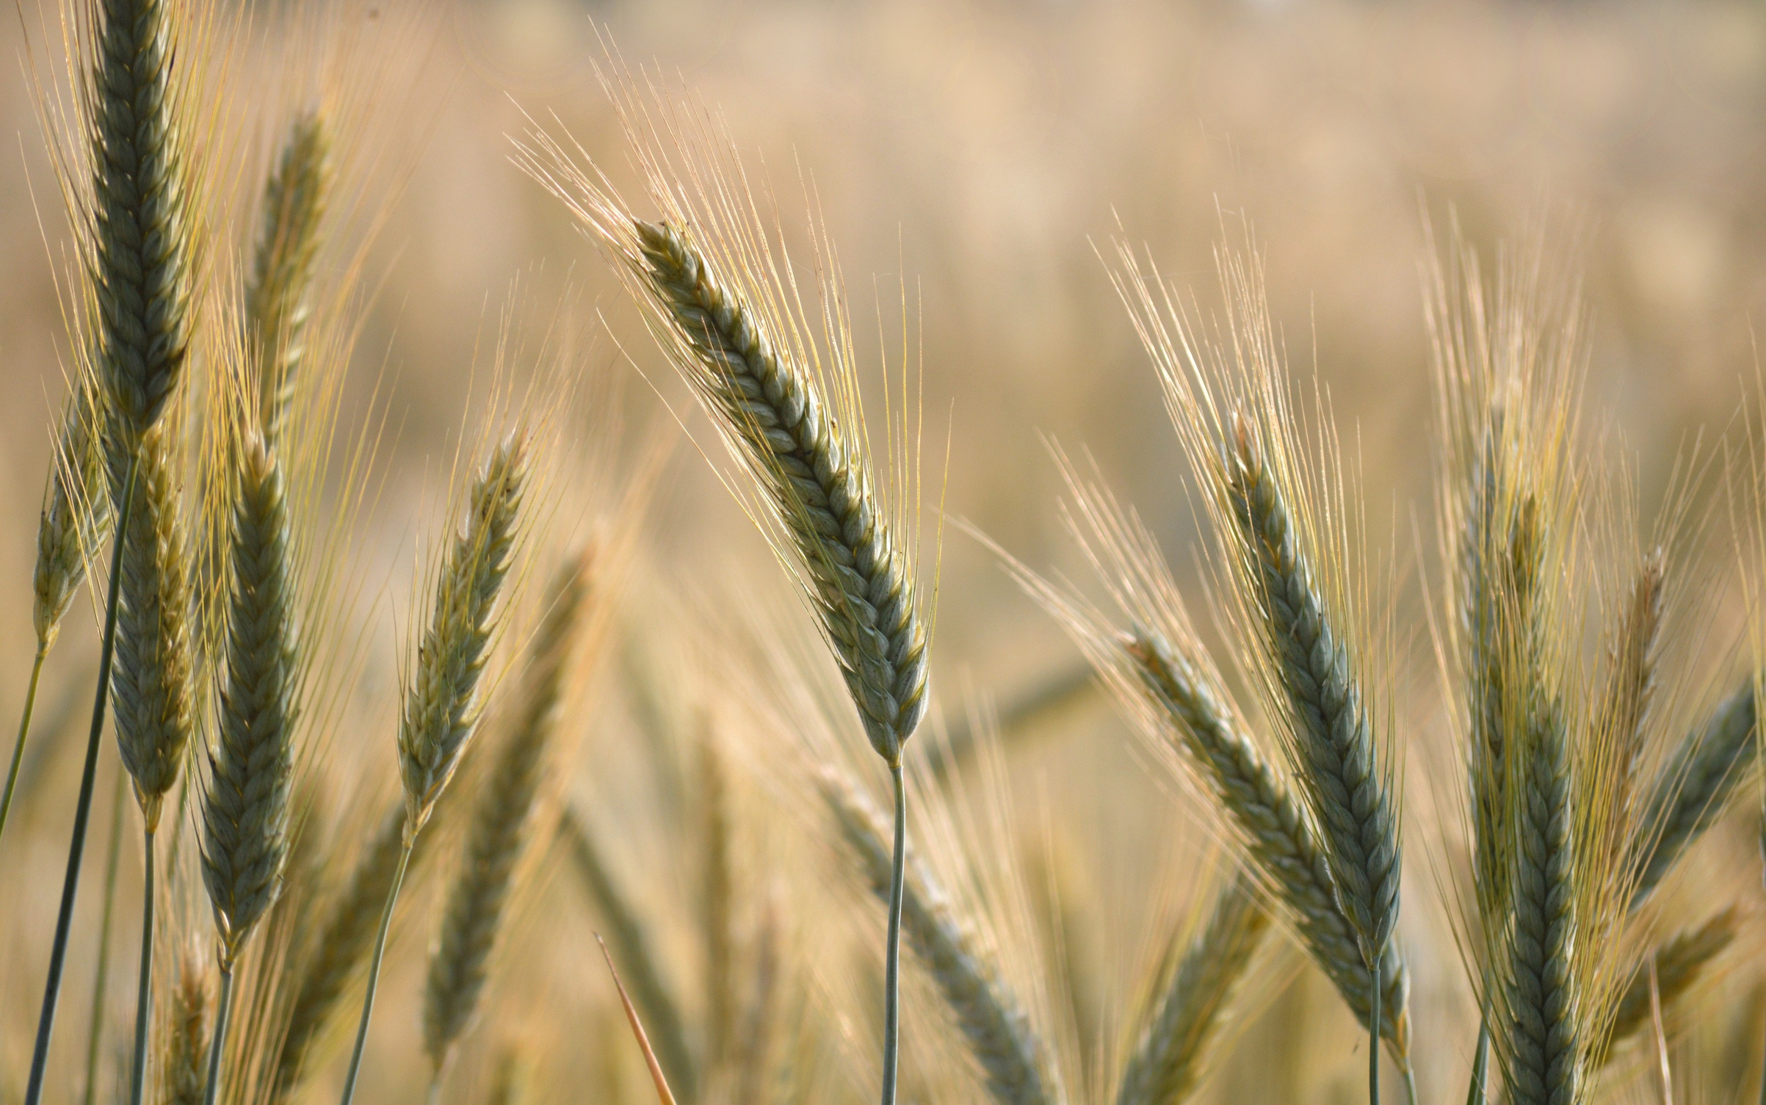
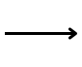
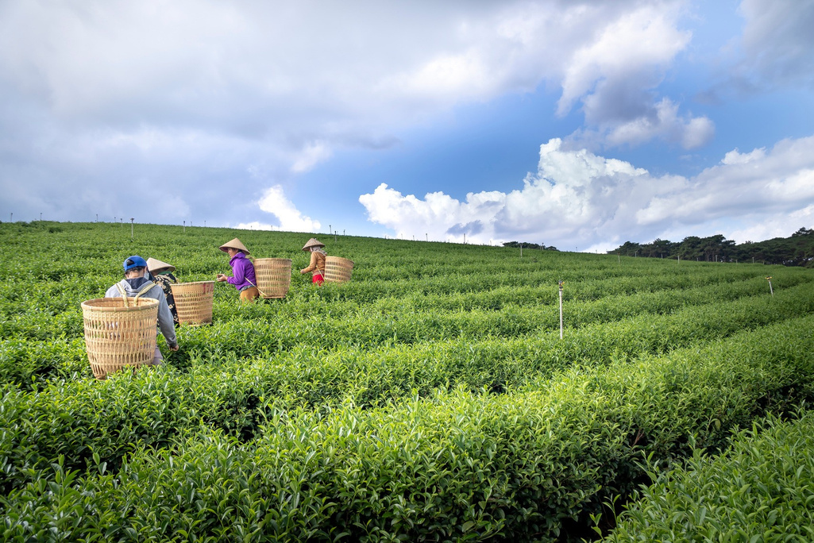
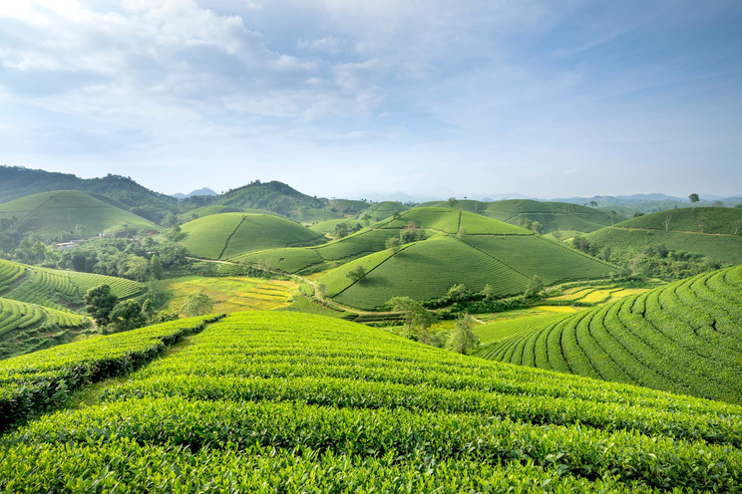
HARVESTHORIZON
A smart Farmer Support System
Present by:
A.DhaniyaSri (B.tech(AI&DS))
K .Kowsalya(B.tech(AI&DS)) K .Shalini(B.tech(AI&DS)) S.Mahalakshmi Mahalakshmi (B.E(CSE))

Slide 2

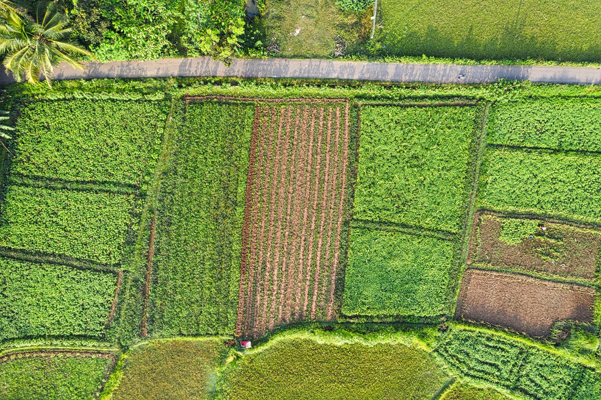
Introduction
HarvestHorizon ---- A smart Farmer support System
Purpose :
➡
Object-Oriented Programming (OOP) Java Collections (ArrayList, HashMap) Conditional Logic & Automation
➡
➡
Core cocept used :
Tracksdaily crop price variations
Detectsdiseases & gives treatment tips Calculates rainfall compensation automatically Generates smart reports with profit/loss details
what it does:
Tomakefarming smarter, efficient, and data-driven

Slide 3

🌾
To create an intelligent crop analysis system using Java that simplifies farming
decisions through automation and data insights.
our core aim:
🌱
Enable real-time crop price comparison for profit/loss detection Provide rainfall impact analysis and compensation estimation Identify crop diseases and suggest instant remedies Deliver smart, report-based insights for farmers Encourage tech-driven, sustainable agriculture
💧
🦠
📊
🌍
essence:
Transforming traditional farming into a smart, automated, and data-powered experience.

Slide 4
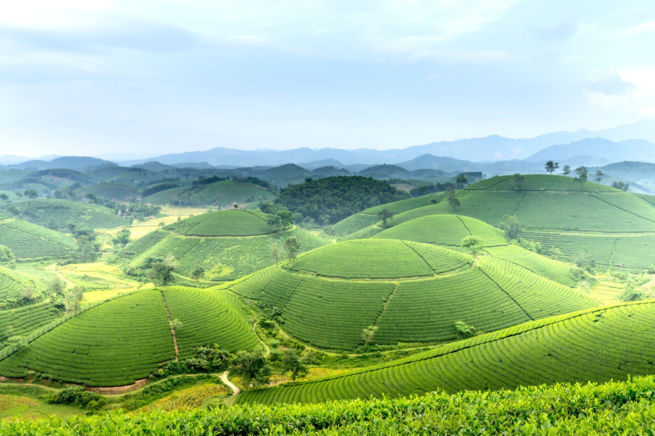


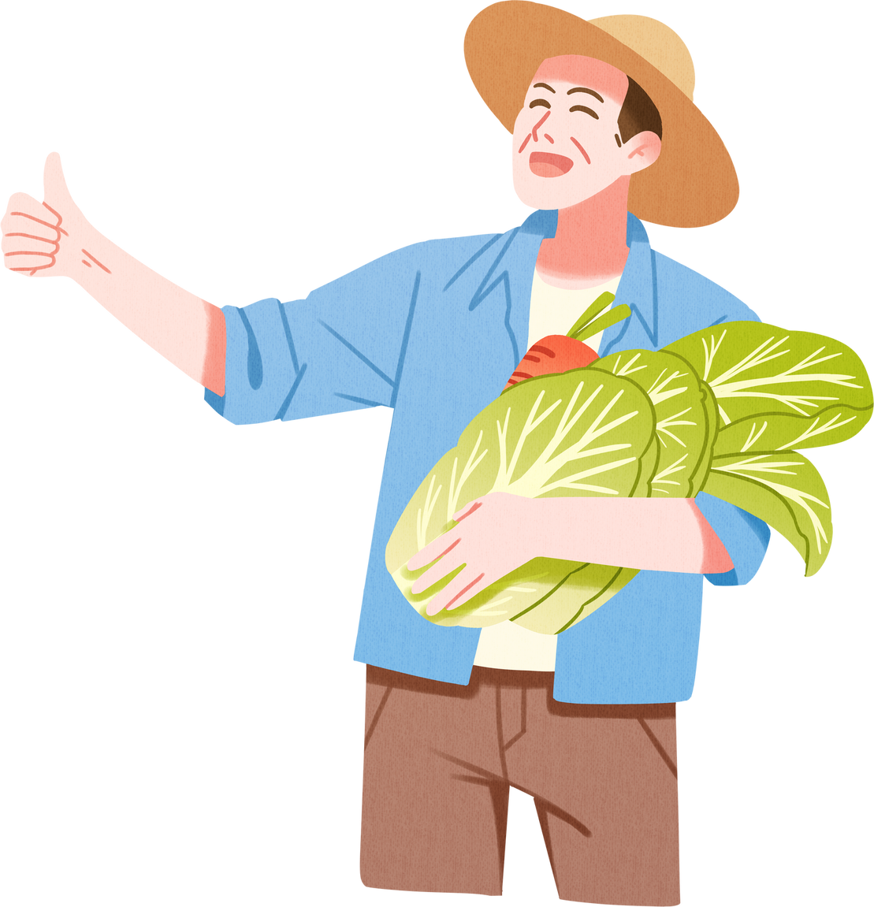

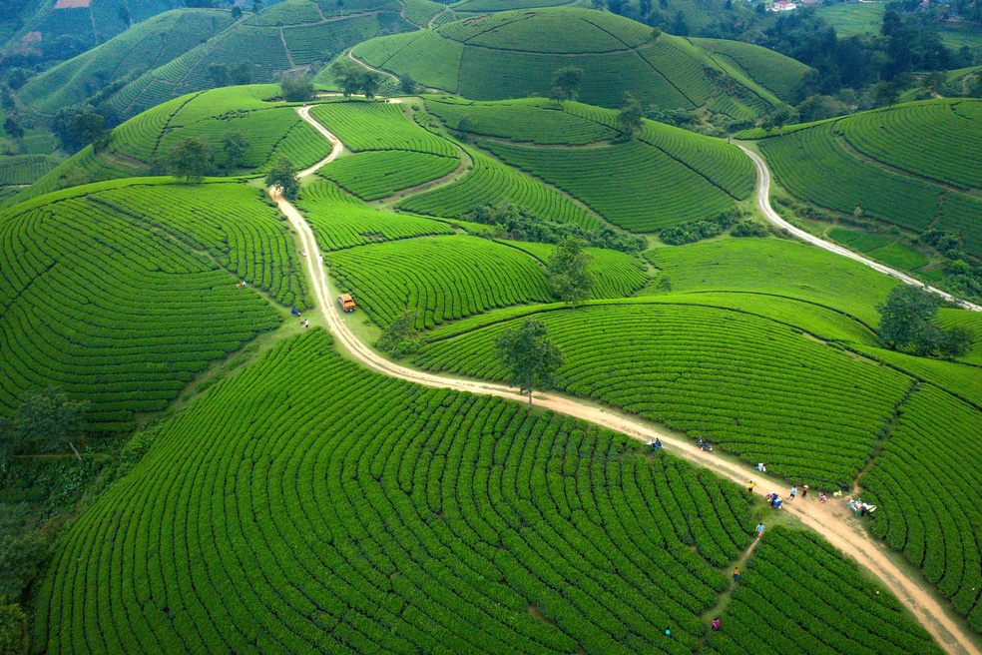

problem statement :
🌾
Intoday’sagriculture,farmersface major challenges due to:
⚖
Unstable crop prices, leading to uncertain income Unidentified crop diseases causing heavy yield losses
🦠
💧
Rainfall damage without proper compensation tracking Lack of data-driven insights for decision-making Manual record-keeping, making monitoring difficult
📉
📋
needs:
Asmart system that can automatically analyze crop data, detect issues, and guide farmers with actionable solutions.

Slide 5
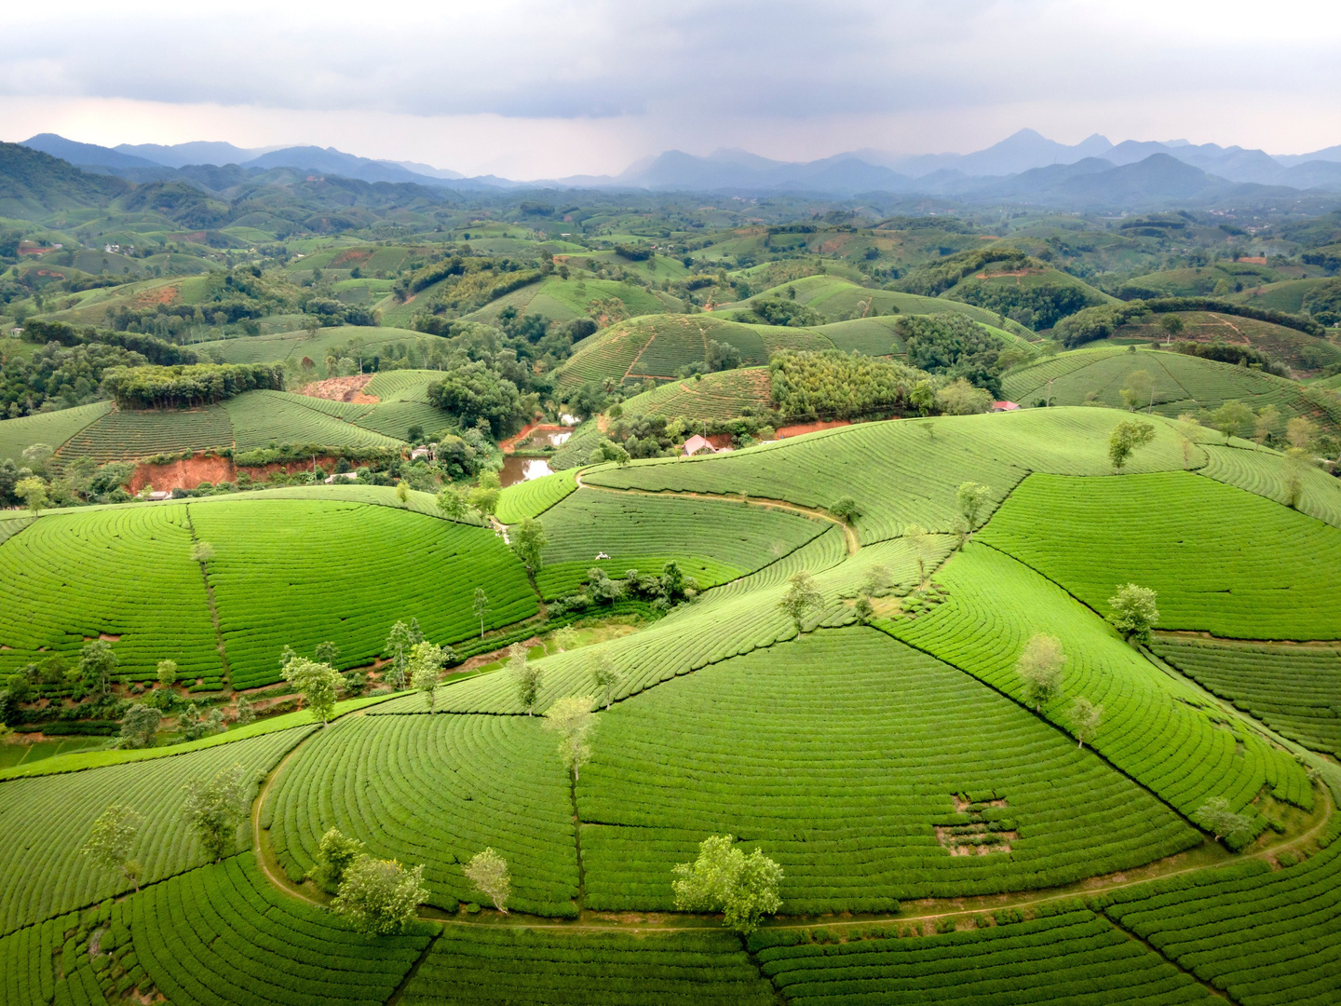

⚙
METHODOLOGY
🌾 Step1–DataCollection:
Farmerinputsdetailslikename,landsize, crop, and season.
🌾
Step 2 – Automated Data Fetching:
System retrieves today’s and yesterday’s crop prices from a stored database.
🌾
Step 3 – Disease Detection:
Automatically identifies possible crop diseases and gives treatment suggestions.
🌾
Step 4 – Rainfall Analysis:
Calculatescompensationfortherain-affected land area.
🌾
Step 5 – Report Generation:
Generates a detailed report showing profit/loss, disease info, and compensation details.
🌾
Step 6 – Summary Display:
Shows final summary of all crops with market comparison and total compensation.

Slide 6

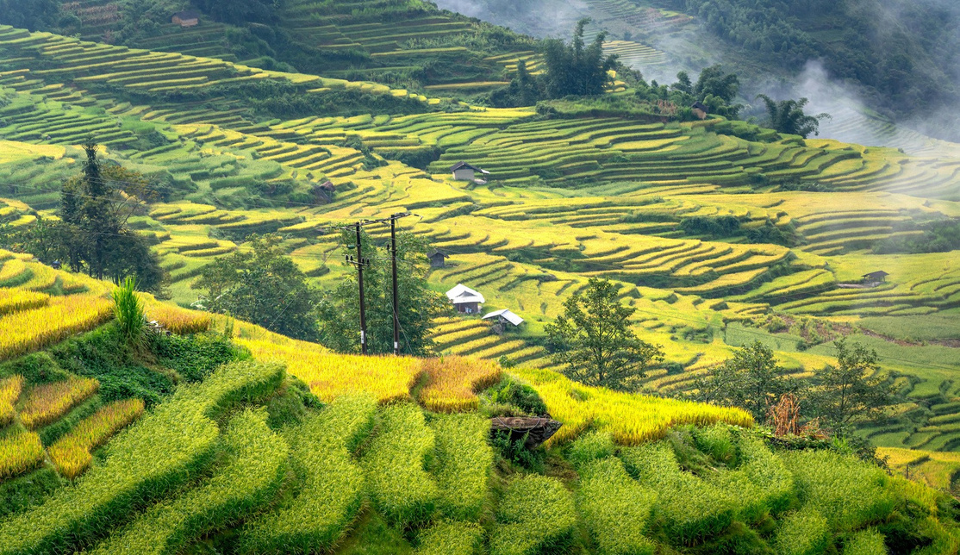
workflow :
START
│ ▼
Ask Farmer Name & Land Size
│ ▼
Crop Selection: - DisplayCrop List - Farmerselects crop
│ ▼
Season Selection: - Display available seasons - Farmerselects season
│ ▼
Auto-Fetch Prices: - Today’sPrice - Yesterday’sPrice
│
▼
Disease Check:
├─
If Yes → Detect disease automatically from crop-disease map
└─ If No → Setdisease = None
│
▼
Rainfall Check:
├─
If Yes → Enter affectedland,calculate compensation
└─ If No → Setcompensation = 0
│
▼
Generate Crop Report:
- Show price change, diseaseinfo, and compensation
│
▼
Add AnotherCrop?
├─
Yes → RepeatfromCrop Selection
└─ No→Proceed
│
▼
FinalSummary:
- Profit/Lossforall crops - Totalcompensation - Marketpricetable
│
▼
END

Slide 7
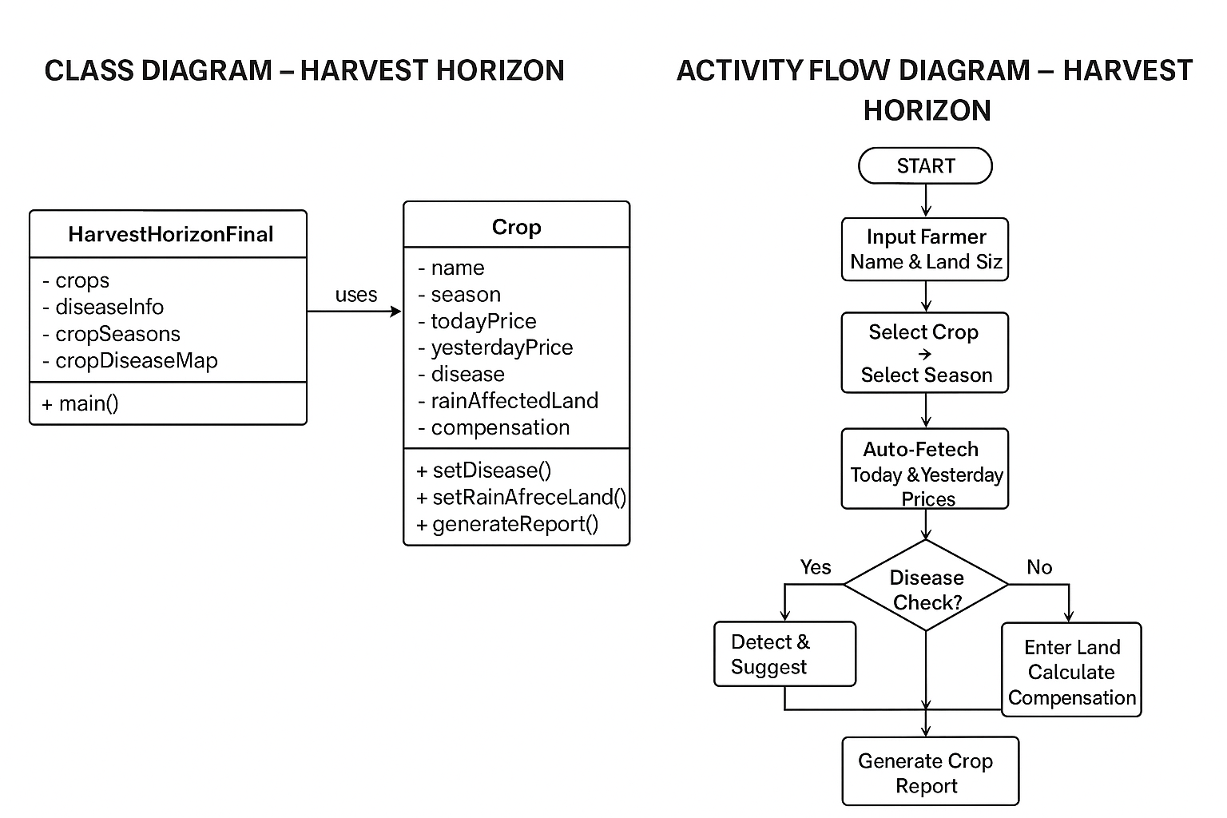

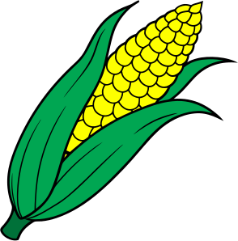
uml diagram :

Slide 8

📊
COMPARISON – HARVEST HORIZON
Crop Health:
Price Monitoring:
TracksTodayvsYesterdayfor allcrops
💰
Detects diseases automatically
🦠
Highlights profit (↑) or loss (↓) instantly
Provides treatmentsuggestions
💊
Ensures healthy yield
Overall Efficiency:
Rainfall Compensation:
Croppricemonitoring
✅
Automatic vs
❌
Manual
Disease detection
✅
Auto vs
❌
Manual
Rainfall compensation
✅
Auto vs
❌
Manual
Compares affected vs total land Calculates compensation automatically
Profit/Loss summary
✅
Instant vs
❌
Not Clear
Farmer decision support
✅
High vs
❌
Low

Slide 9

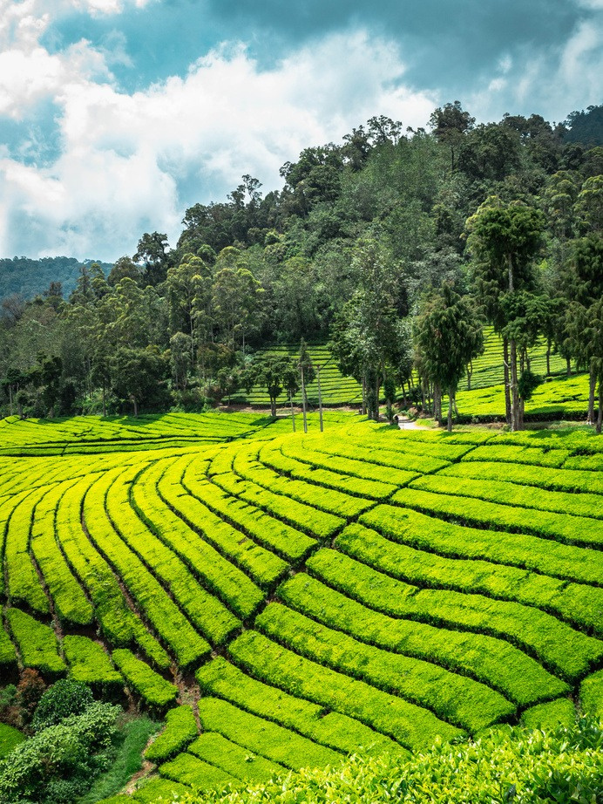
🚀
FUTURE SCOPE – HARVEST HORIZON
Mobile & Web App:
Access reports anytime
📱💻
Live Market Updates:
🏬
Real-time crop prices
AI Disease Prediction:
Earlydetection of crop diseases
🦠🤖
Weather Integration:
Anticipaterainfall & damage
🌦
Graphs & Dashboards:
Easyvisualization of crop data
📊
Goal :
Make farming smarter, automated, and data-driven
🌾💡🌍

Slide 10
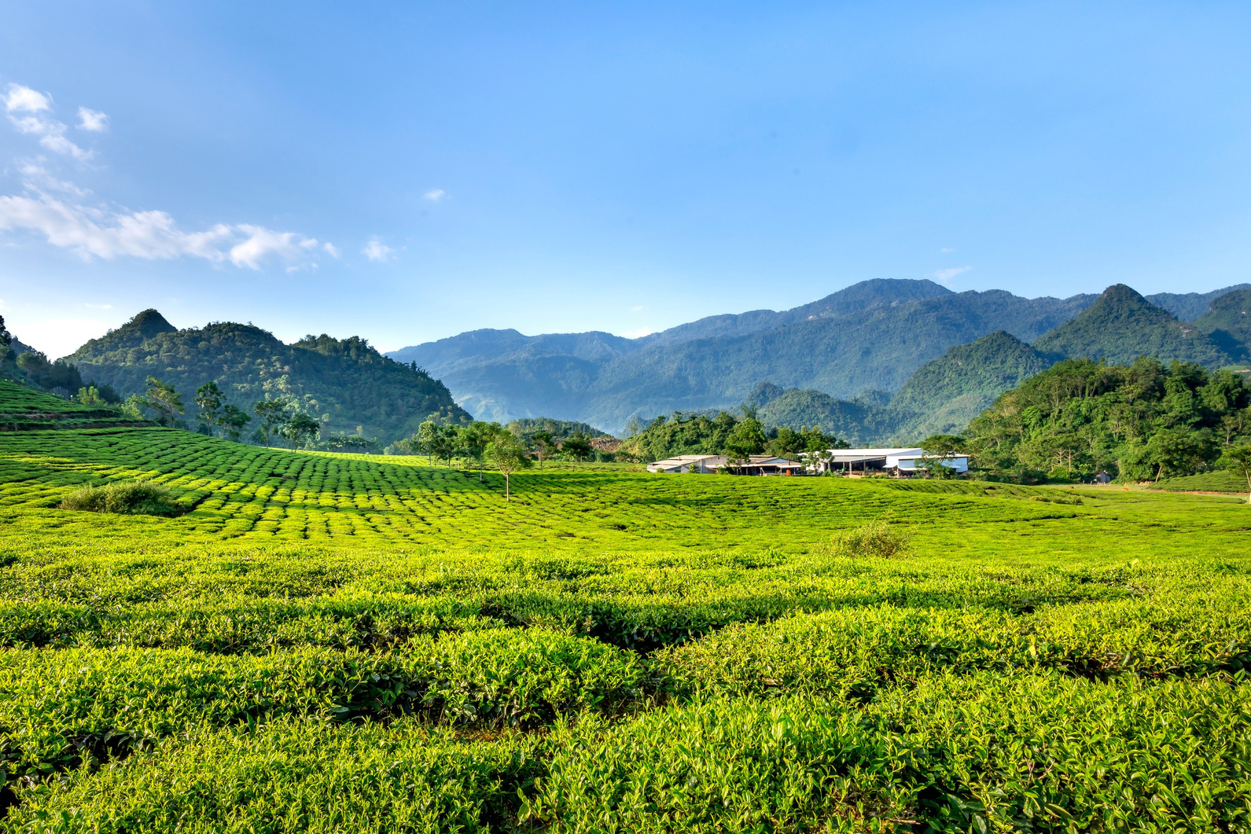
Thank You!

